Slide 1
INTERNSHIP AT SELISE

Slide 2
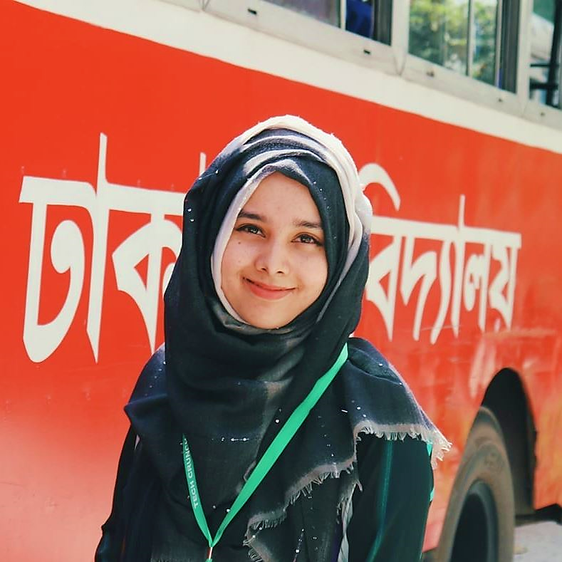
Hello!
I am Ishrat Jahan Emu
BSSE 0927
Session-2016-17

Slide 3
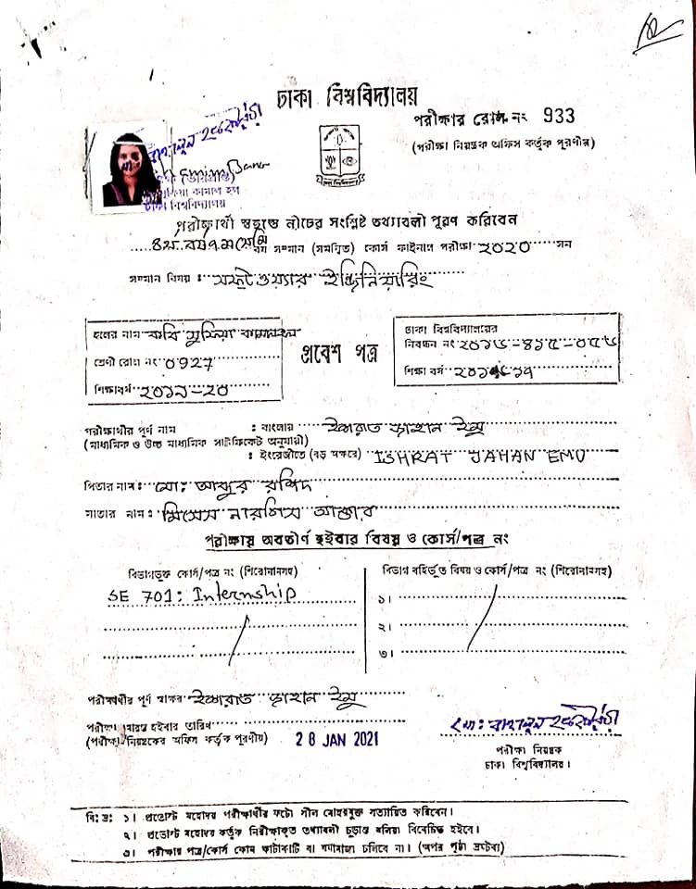
Admit Card

Slide 4
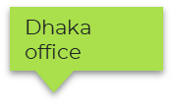
Selise Location
Zürich
Office
Thimpu office
Dubai Office
4

Slide 5
About Selise
300+ Employees
110 +
customers
90+ Applications

Slide 6





Used Technology in SELISE
Angular (Front end technology)
Graphql (Front end and backend query API)
MongoDB (Database)
Dotnet (Backend microservices technology)
ECAP3 (SELISE made library)

Slide 7
Work From Home
Working time monitoring Via Email
Google Meet
Hangout
Slack Channels
Remote Desktop Connection

Slide 8


Assigned Project

Slide 9
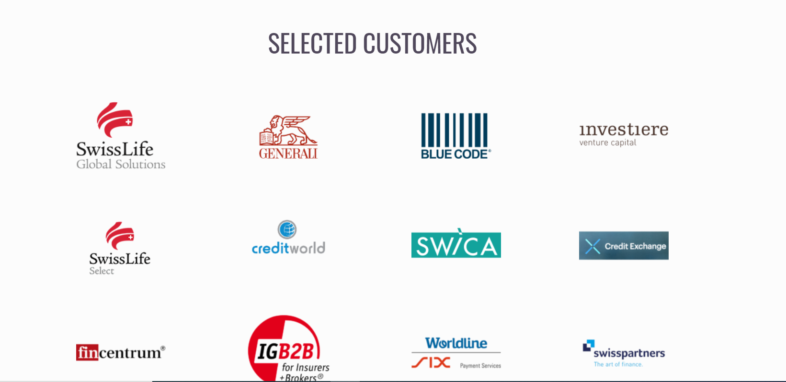
Assigned Project description
My Assigned Team: Select Network
It has four Market

Slide 10
Assigned Project description
My Assigned Team: Select Network
It has four Market:
Select Network-AT
Select Network-CZ
Select Network-FCCZ
Select Network-FCSK

Slide 11
Assigned Project description
Financial consulting
European Insurance company
Main goal is to digitize insurance and finance works
Generating documents and calculation of various insurance data from brokers or customers

Slide 12
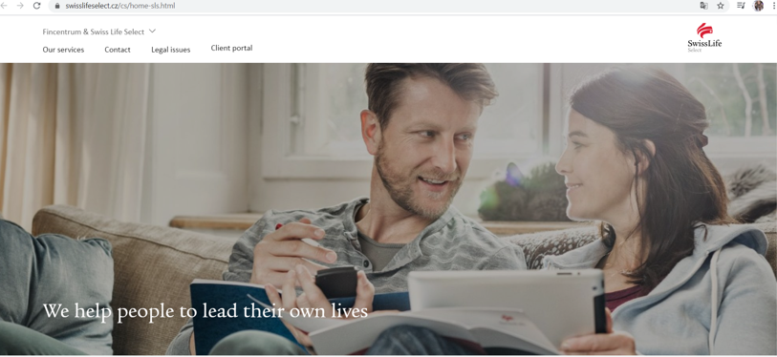
Front Page

Slide 13
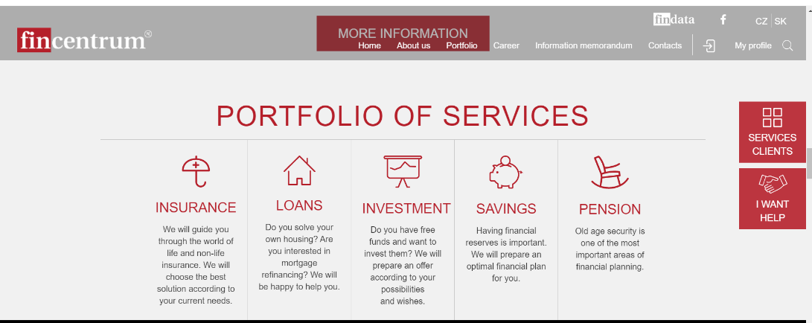
Front Page

Slide 14
Project development process
1. Collect Requirements from client by business analysts
2. Plan with developers and UX designers
3. Make specs by UX designers.
4. Implement designs and functionality by developers
5. Test current implementation and give demo to CPO/CTO
6. Provide to client for acceptance

Slide 15
Technical Project Description
Authentication module made by existing ECAP3 libraries
Identity Access Management(IAM) module designed business specifically, functionality used by existing ECAP3
Proposal module developed using angular, graphql API, and dotnet micro services
All data stored in three servers
Development server
Staging server
Production server

Slide 16
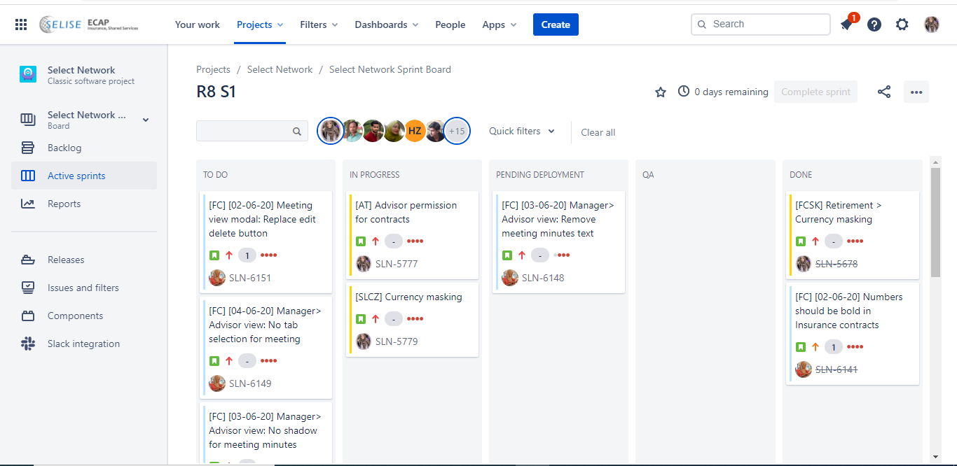
Planning in Agile board

Slide 17
My Contribution
Implement a data-table
Currency Masking
Meeting View Model
Advisor view
Creating Forms & implement all features for Goal submenu
Testing
And so on

Slide 18
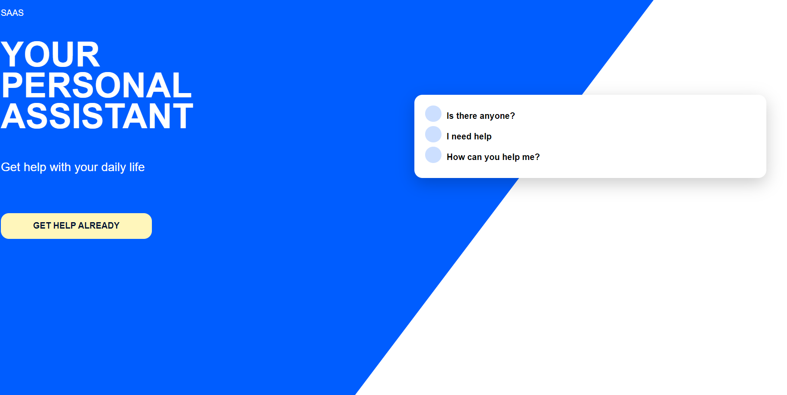
My Work Demo

Slide 19
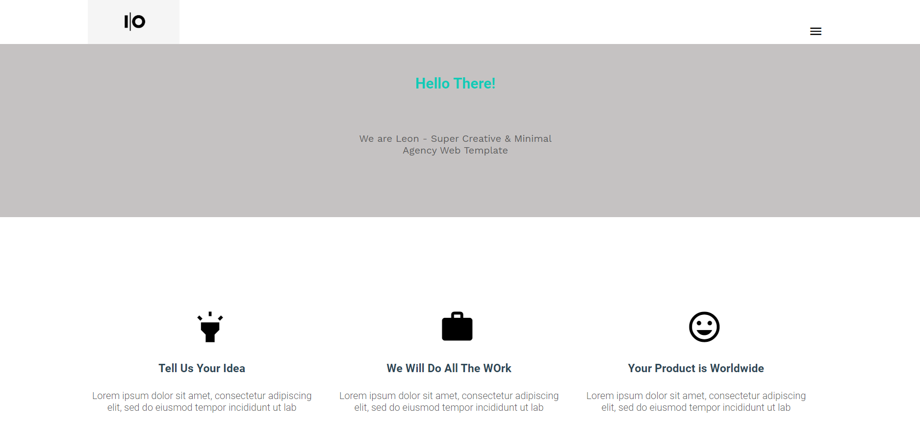
My Work Demo

Slide 20
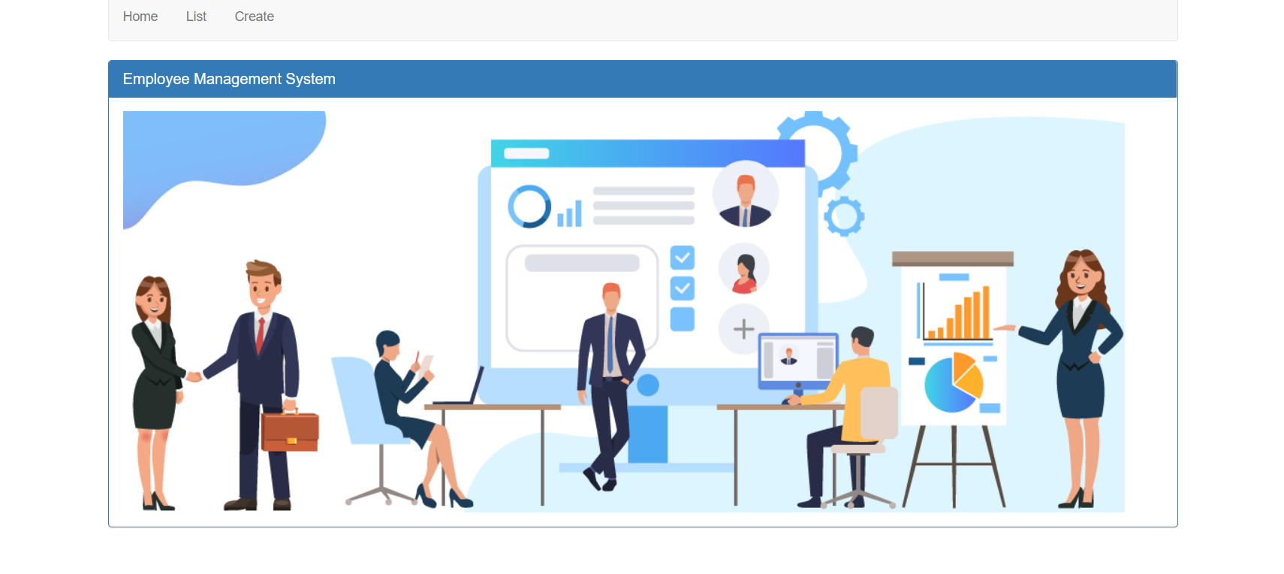
My Work Demo

Slide 21





Technologies

Slide 22






Tools

Slide 23
Soft Skills
Team Work
Adaptability
Time Management

Slide 24
My Learnings & acquired skills
Developing project in agile process involving scrum, sprint, demo etc
Team work and communication with frontend developer, backend developer, UX designer, Business analyst and tester
Front end Angular technology

Slide 25
My Learnings & acquired skills
Opportunity to work in real life project
Work From Home Experience
Learning new language & technologies

Slide 26
Challenges and Difficulties
Learning new technologies as fast as possible
Internet Issue
Working with Large Team

Slide 27
Thanks!
Any questions?

